Slide 1
Entrepreneurship and Leadership
Business School
BSCS Lecture 1 (week 2)

Slide 2
Ideas for startup
It’s not necessary to do a major breakthrough to become an entrepreneur
An entrepreneur can a solve a common problem by providing simple solutions
Great companies began by asking simple questions

Slide 3
Ideas for startup
THEREFORE, WHAT?
This question arises when you spot or predict a trend and wonder about its consequences.
It works like this: “Everyone will have a smartphone with a camera and Internet access.”
Therefore, what?
“They will be able to take pictures and share them.”
Therefore, what?
“We should create an app that lets people upload their photos, rate the photos of others, and post comments.” INSTAGRAM
TIKTOK “DOUYIN” started which is used to make variety of short-form videos from genres like dance and comedy that have a duration of 30 seconds to 1 minute.

Slide 4
Ideas for startup
ISN’T THIS INTERESTING?
Intellectual curiosity and accidental discovery power this method.
Spencer Silver was trying to make glue but created a substance that barely holds paper together . Post-it Notes
Cocoo’s den –temple led restaurant located in food street of Lahore.
https://www.youtube.com/watch?v=W0mv0Bd9Id4

Slide 5
Ideas for startup
IS THERE A BETTER WAY?
Frustration with the current state of the art is the hallmark of this path.
Qconnects bus service Lahore to Islamabad
https://www.youtube.com/watch?v=4EBx3cs3gu4&t=21s
WHY DOESN’T OUR COMPANY DO THIS?
Frustration with your current employer is the catalyzing force in this case
You tell your management that the company should create a product because customers need it, but management doesn’t listen to you.
Finally , you give up and do it yourself.

Slide 6
Ideas for startup
IT’S POSSIBLE, SO WHY DON’T WE MAKE IT?
Markets for big innovations are seldom proven in advance, so a what-the-hell attitude characterizes this path
For example, back in the 1970s a portable phone was incomprehensible to most people when Motorola invented it
However , Martin Cooper and the engineers at Motorola went ahead and made it, and the rest is history

Slide 7
Ideas for startup
WHERE IS THE MARKET LEADER WEAK?
Three conditions make a market leader vulnerable:
First, when the leader is committed to a way of doing business. For example, IBM distributed computers through resellers, so Dell could innovate by selling direct.
Second, when the customers of the leader are dissatisfied. For example, the necessity to drive to Blockbuster stores to pick up and return videos opened the door for Netflix.
Third, when the market leader is milking a cash cow and stops innovating. This is what Microsoft Office susceptible to Google Docs.

Slide 8
Exercise/ Class activity
Complete this sentence:
If your startup never existed, the world would be worse off because __________.

Slide 9
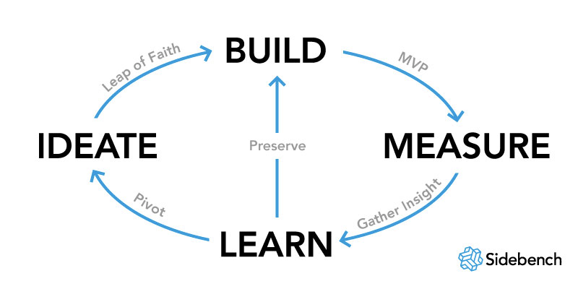
Lean start up method

Slide 10
Schools of Thought in Entrepreneurship
Three major schools of thought:
“Just Do It”
Most entrepreneurs are wary of implementing traditional management practices, afraid that this will invite bureaucracy or stifle creativity
They assume management is the problem, hence, chaos is the answer
Unfortunately, this approach leads to chaos more often than it does to success
“Launch a Rocket Ship”
Specify every single step to take in excruciating details (typically by tapping into a proven set of techniques used for managing big companies)
Specify the expected result of every single step taken– what happens if a tiny error occurs? Can you adapt or pivot?

Slide 11
Schools of Thought in Entrepreneurship
Three major schools of thought:
“Drive a Car”
Set a (hypothetical) path to reach a destination (you are not sure whether this path will lead to the destination)
Experiment with and validate your path
Persevere, adapt, or even pivot if needed
If you are driving to work, do you give up if there is a detour in the road or you made a wrong turn?
No, you remain thoroughly focused on getting to your destination
The third school of though is the recommended one!

Slide 12
Home Assignment
Identify the three best entrepreneurships that you admire. List the reason for doing so
Identify and research three successful Entrepreneurs you admire and look up to. What characteristics do they have that makes them a successful entrepreneur?

